Slide 1
Objects and Methods (Chapter 6)
Math class
Wrapper classes
Overloaded methods

Slide 2
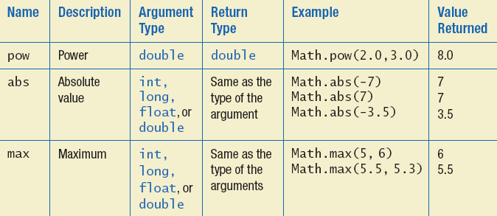
The Math Class
Provides many standard mathematical methods
    Automatically provided, no import needed
Example methods

Slide 3
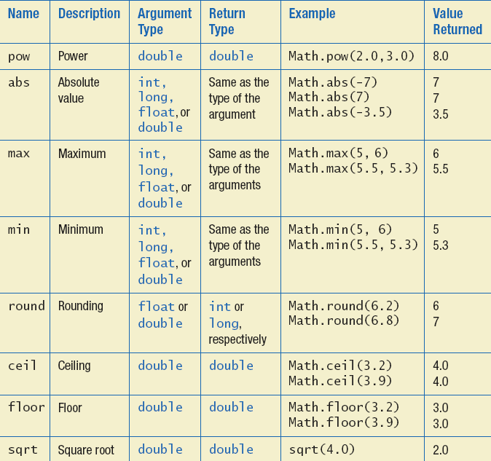
The Math Class
Example methods

Slide 4
Random Numbers
Math.random() returns a random double that is greater than or equal to zero and less than 1
Java also has a Random class to generate random numbers
Can scale using addition and multiplication; the following simulates rolling a six sided die
  int die = (int) (6.0 * Math.random()) + 1;

Slide 5
Wrapper Classes
Java provides wrapper classes for each primitive type
    Methods provided to act on values
    Allow programmer to have an object that corresponds to value of primitive type
    Contain useful predefined constants and methods
    Wrapper classes have no default constructor
      Programmer must specify an initializing value when creating new object
    Wrapper classes have no set methods

Slide 6
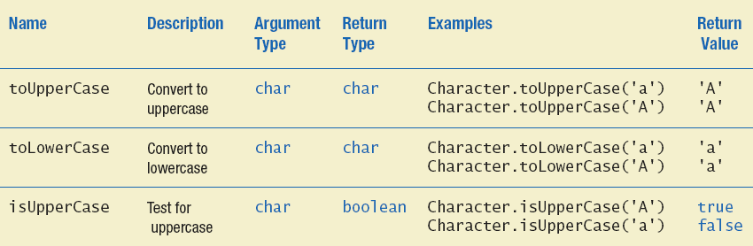
Wrapper Classes
Static methods in class Character

Slide 7
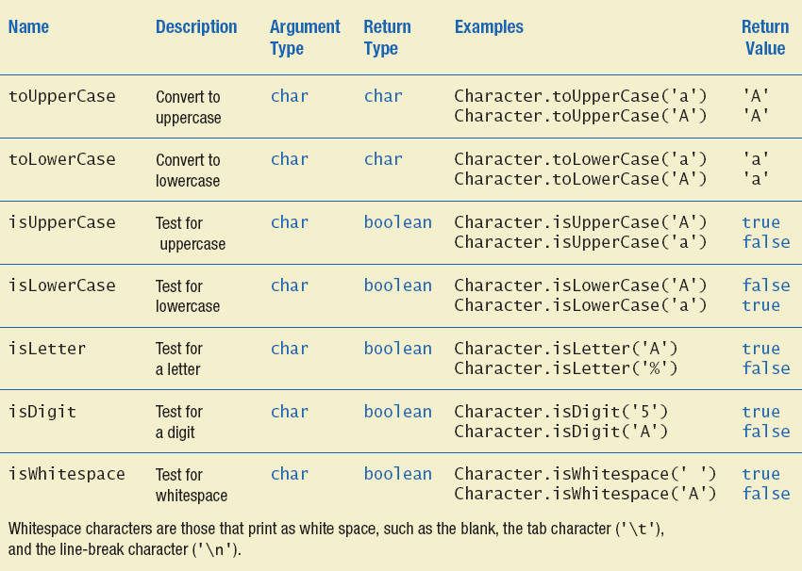
Wrapper Classes
Static methods in class Character

Slide 8
Decomposition
With this pseudocode we decompose the task into subtasks
    Then solve each subtask
    Combine code of subtasks
    Place in a method

Slide 9
Addressing Compiler Concerns
Compiler ensures necessary tasks are done
    Initialize variables
    Include return statement
Rule of thumb: believe the compiler
    Change the code as requested by compiler
    It is most likely correct

Slide 10
Testing Methods
To test a method use a driver program
Every method in a class should be tested
Bottom-up testing
    Test code at end of sequence of method calls first

Slide 11
Overloading Basics
When two or more methods have same name within the same class
Java distinguishes the methods by number and types of parameters
    If it cannot match a call with a definition, it attempts to do type conversions
A method's name and number and type of parameters is called the signature

Slide 12
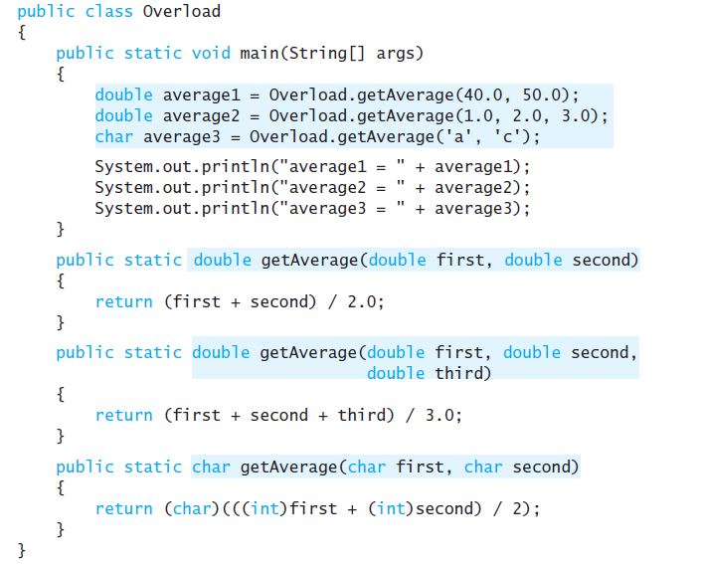
Overloading Basics – example

Slide 13
Overloading and Type Conversion
Overloading and automatic type conversion can conflict
Remember the compiler attempts to overload before it does type conversion

Slide 14
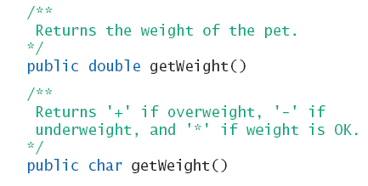
Overloading and Return Type
You must not overload a method where the only difference is the type of value returned !!

Slide 15
Programming Example
public class Money
{
public void set(long newDollars) {
}
public void set(double newAmount) {
}
public void set(Money moneyObject) {
}
}

